Slide 1

HOW TO DO YOUTUBE
An analysis of the top youtube channels
By Marco and Melissa
Notes:
We looked at the top youtube channels by subscirber count targeting up and coming youtubers looking to take their channel to that next level. There are many ways to appraoch this, but we decided to look at the variables associated with CHANNELS.

Slide 2
What does it take to make a top Youtube Channel?
Is there a relationship between genre tag and total view counts/subscriber counts/video counts?
H₀ : Count means are equal across genres, or 𝜇1=𝜇1=𝜇3
H₁ : Count means are not equal across genres - one
Is there a relationship between country of origin and total view counts/subscriber counts/video counts?
H₀ : Count means are equal between countries, or 𝜇1=𝜇1=𝜇3
H₁ : Count means are not equal between countries
Notes:
MELISSA

Slide 3
Snapshot of what we found:
-Channels with the entertainment genre tag produce significantly more videos.
-Channels with the music genre tag has significantly more views than lifestyle channels.
-Indian channels produce significantly more videos than other countries.
Notes:
MARCO

Slide 4
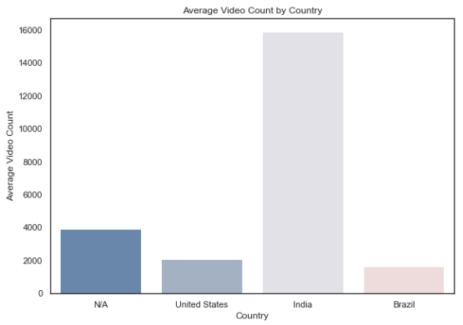






Sources
400 Top YouTube
Channels
Notes:
MARCO

Slide 5
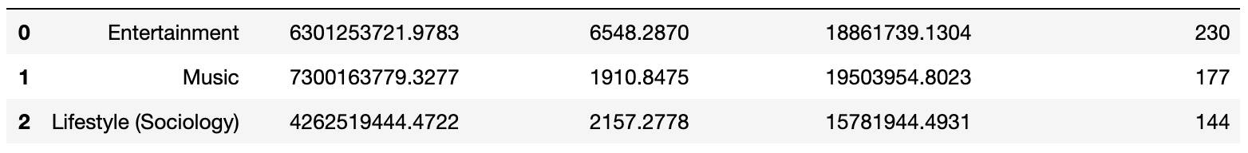
Statistical Analysis: Genre
One Way ANOVA on top 3 genre tags:
Genre tag and View Count
Genre tag and Subscriber Count
Genre tag and Video Count
Genre Tag
Subscriber Count
Video Count
View Count
Count
Notes:
MELISSA For genres, we chose the top three genres which had the highest tag counts. We ran an ANOVA test to see if any genre tag performed significantly better in terms of view counts, subscriber counts and relationship to video counts.

Slide 6
Post Hoc Test - Tukey’s
Significant results between:
View Count:
Entertainment - Lifestyle (Sociology)
Lifestyle (Sociology) - Music
Subscriber Count:
Lifestyle (Sociology) - Music
Entertainment - Lifestyle (Sociology)
Video Count:
Entertainment - Lifestyle (Sociology)
Entertainment - Music
Notes:
MELISSA Many of these tests were barely statistically significant, which the exception between the s ----, There was a significant difference in subscriber counts between the music tag and sociology/lifestyle tag. We also found that Entertainment tagged channels produced significantly more videos than music or lifestyle channels.

Slide 7
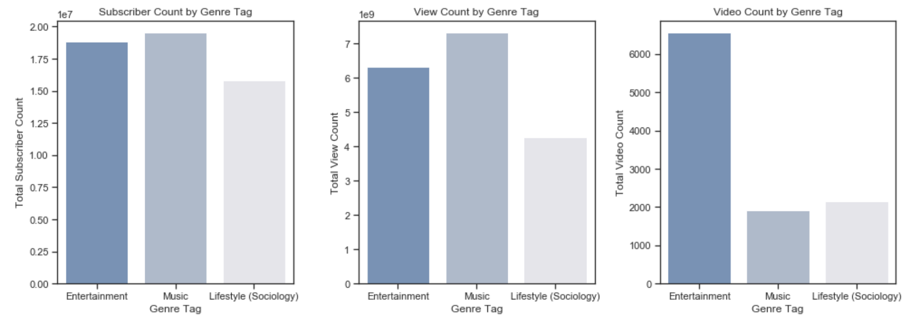
Genre Tag Visualizations:
Notes:
Signifcant differences in view countbetween Entertainment higher view counts than

Slide 8
Statistical Analysis: Countries
Limit to top 4 countries by number of channels in the list:
N/A (intentionally chosen by channel owners)
United States
India
Brazil
Notes:
Intentionality behind whether or not to list your country. Would be interesting to compare stats

Slide 9
Statistical Analysis: Countries
Significant results for:
View Count:
India vs. Brazil
Subscriber Count:
None
Video Count:
Brazil vs. India
India vs. N/A
India vs. US

Slide 10
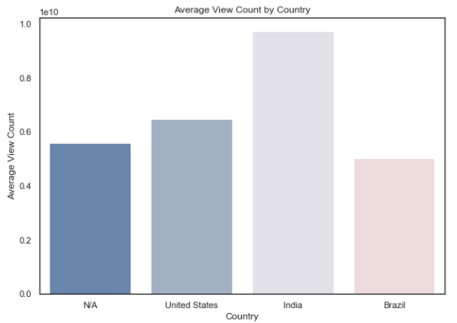
Statistical Analysis: Countries
Significant results for:
View Count:
India vs. Brazil
Subscriber Count:
None
Video Count:
Brazil vs. India
India vs. N/A
India vs. US

Slide 11
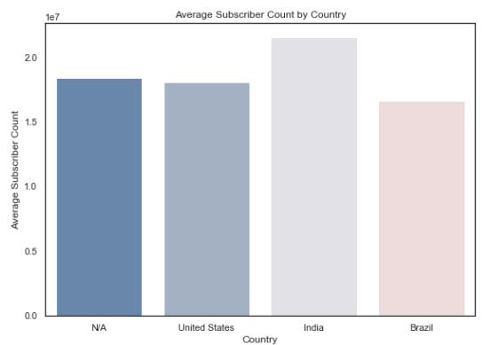
Statistical Analysis: Countries
Significant results for:
View Count:
India vs. Brazil
Subscriber Count:
None
Video Count:
Brazil vs. India
India vs. N/A
India vs. US

Slide 12
Statistical Analysis: Countries
Significant results for:
View Count:
India vs. Brazil
Subscriber Count:
None
Video Count:
India vs. Brazil
India vs. N/A
India vs. US

Slide 13
Recommendations:
For new youtubers!
-In India, you need to make a lot of video content to compete with top channels.
-If subscriber count is your main focus, consider creating a music channel rather than a lifestyle channel.
-If view count is your main focus, entertainment channels and music channels are more likely to bring in big viewership than lifestyle channels ( good to consider for ad revenue!).
-Entertainment channels tend to produce more content, so if you want an entertainment channel to succeed consider quantity over quality..

Slide 14
Study Limitations:
Limited API calls for Youtube
Limited information from YouTube
Difference in sample sizes used in ANOVA
Inexperience! We could have more effectively used our limited API resources to collect more robust data if we had better understood it’s limitations.

Slide 16
Regression Analysis:
View Count and Video Count:
Is there a relationship between video count and view counts?
H₀ : Genre means are equal, or 𝜇1=𝜇1=𝜇3
H₁ : Genre means are not equal
Analysis: Ordinary Least Squares regression analysis.
Results: Reject the Null hypothesis.
Limitations: Huge data set and high numbers. The p-value was tiny (2.8125388045932456e-05).
The condition number is large, 1.95e+04. This might indicate that there are strong multicollinearity or other numerical problems.

